Slide 1
Norfolk Police Department
The Norfolk Police Department in association with the Omega Group has developed a website whereby citizens can view crimes in their neighborhoods and sign up for alerts for crimes close to their residences or businesses.
www.crimemapping.com
The following slides will demonstrate the procedure for alerts sign-up

Slide 2
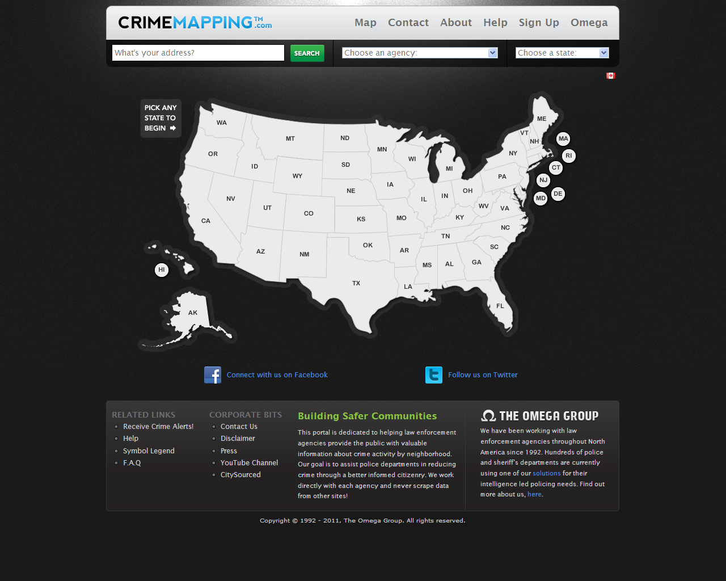

Slide 3
Click on Virginia

Slide 4
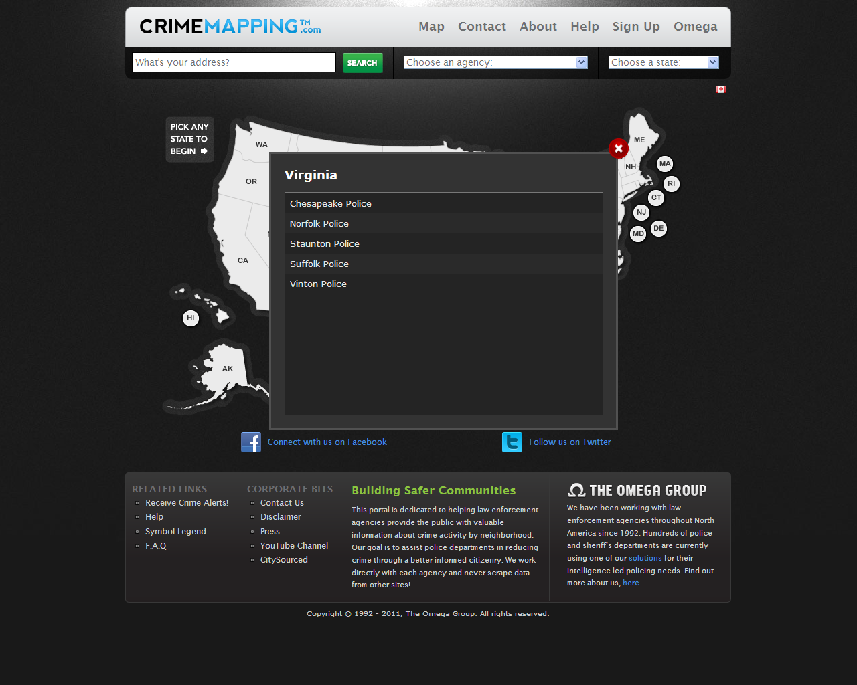
Click on Norfolk Police

Slide 5
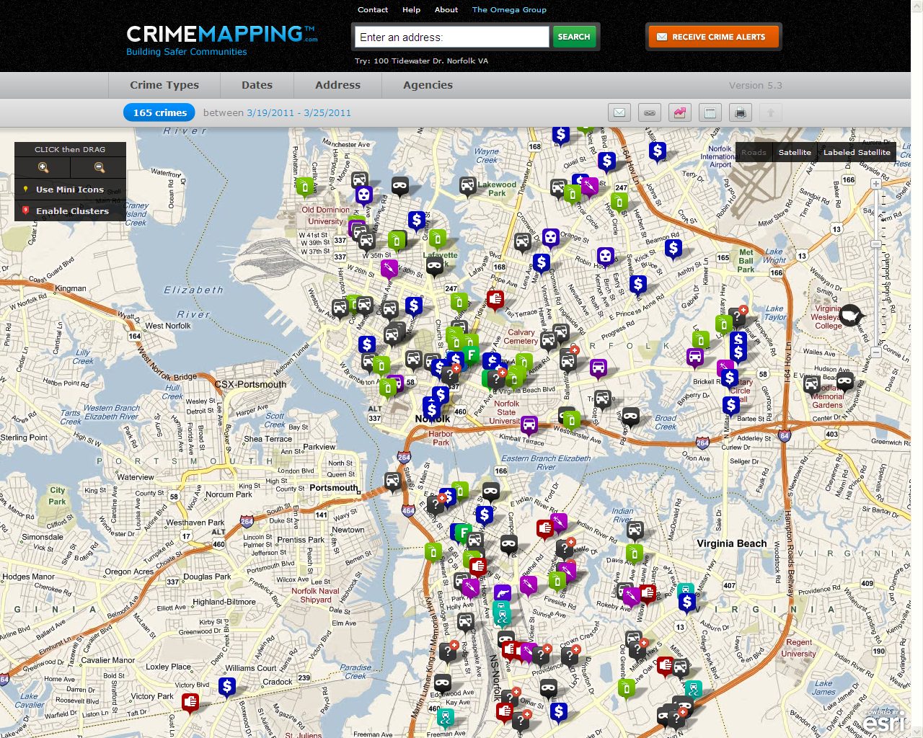

Slide 6
Click here

Slide 7
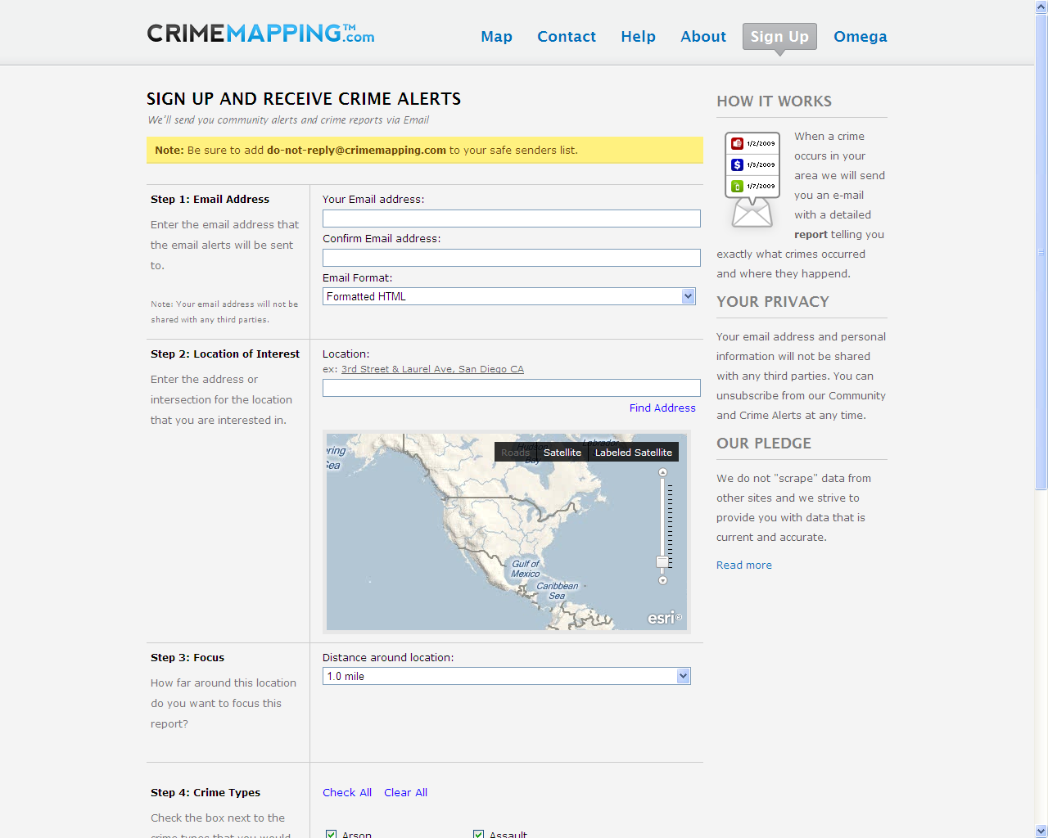

Slide 8
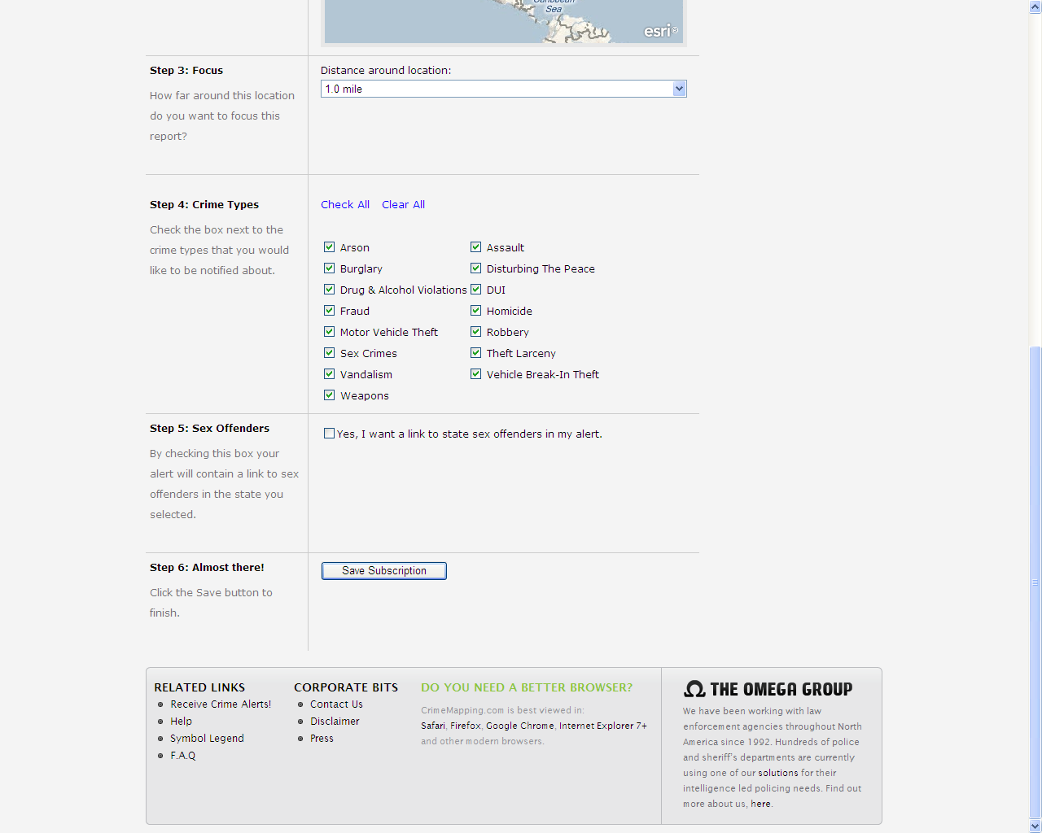

Slide 9
Norfolk Police Department
Once you have finished steps 1-6 on the “Sign up and receive crime alerts” web page, (previous two slides) an email will be sent to the email address provided. This email will contain information confirming your preferences and validating the email address.

